Slide 1
OTP CRC Check
Ivan Seet
12/05/2023

Slide 2
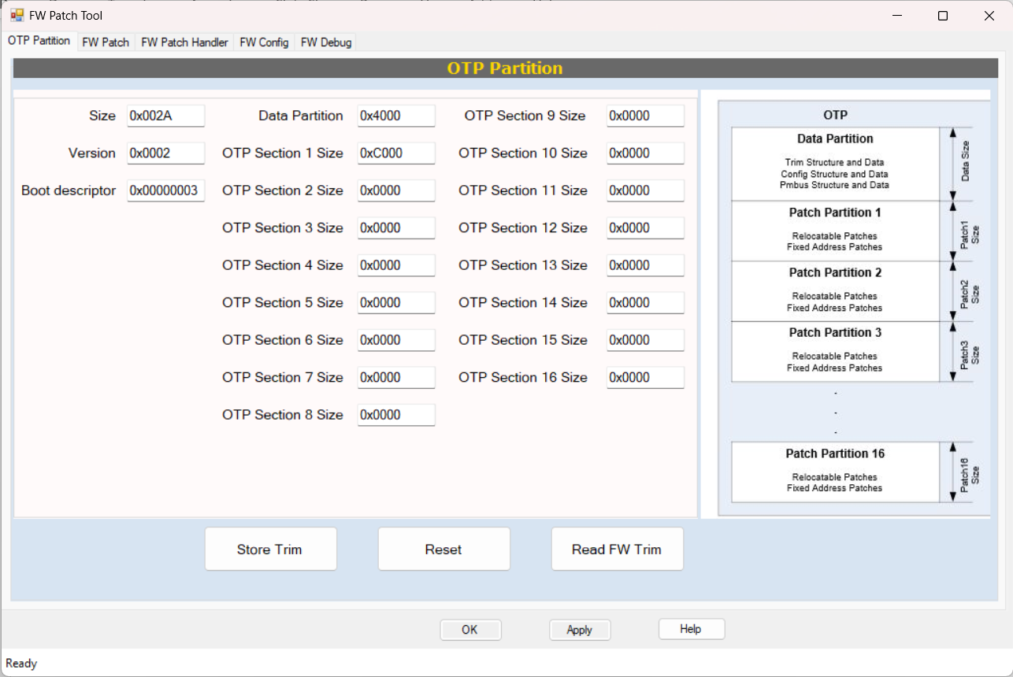
OTP Store
OTP is store with basic configuration in partition 0(Data Partition)

Slide 3
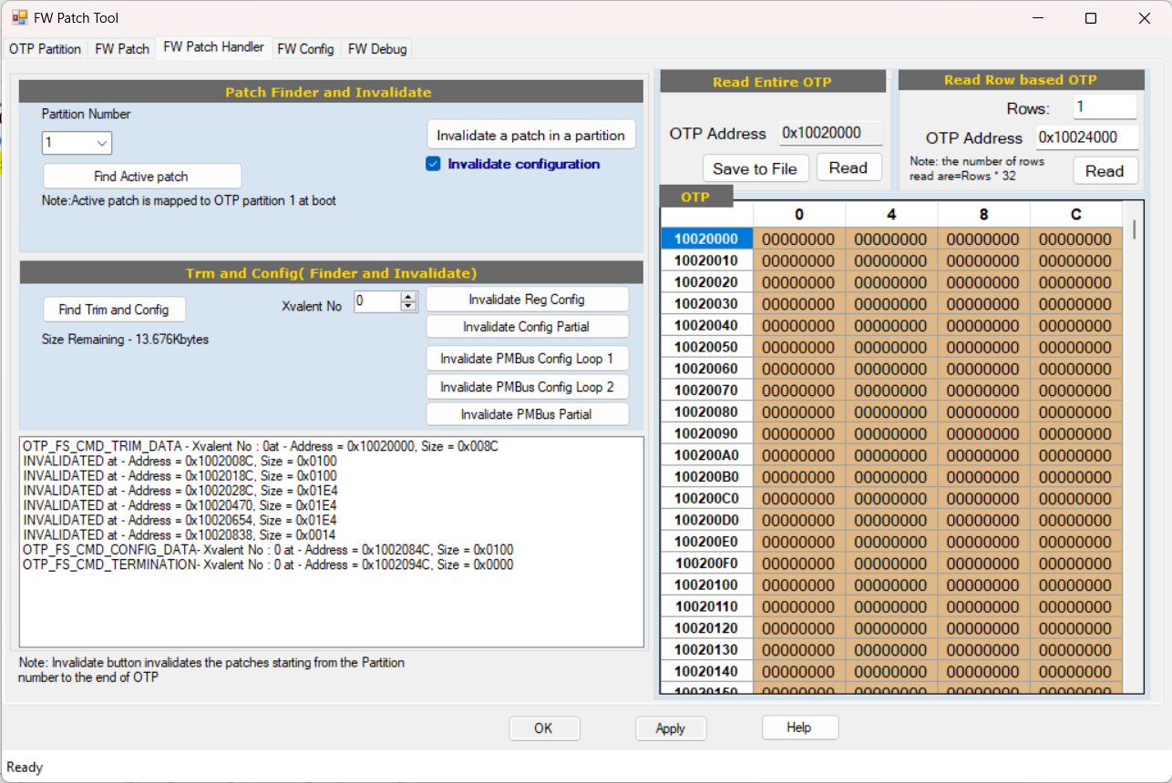
OTP Store
OTP is store with basic configuration in partition 0(Data Partition)

Slide 4
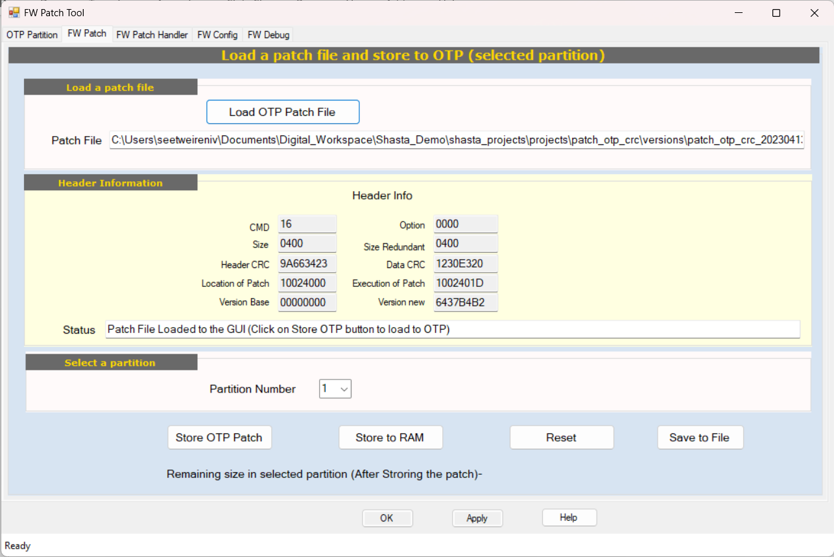
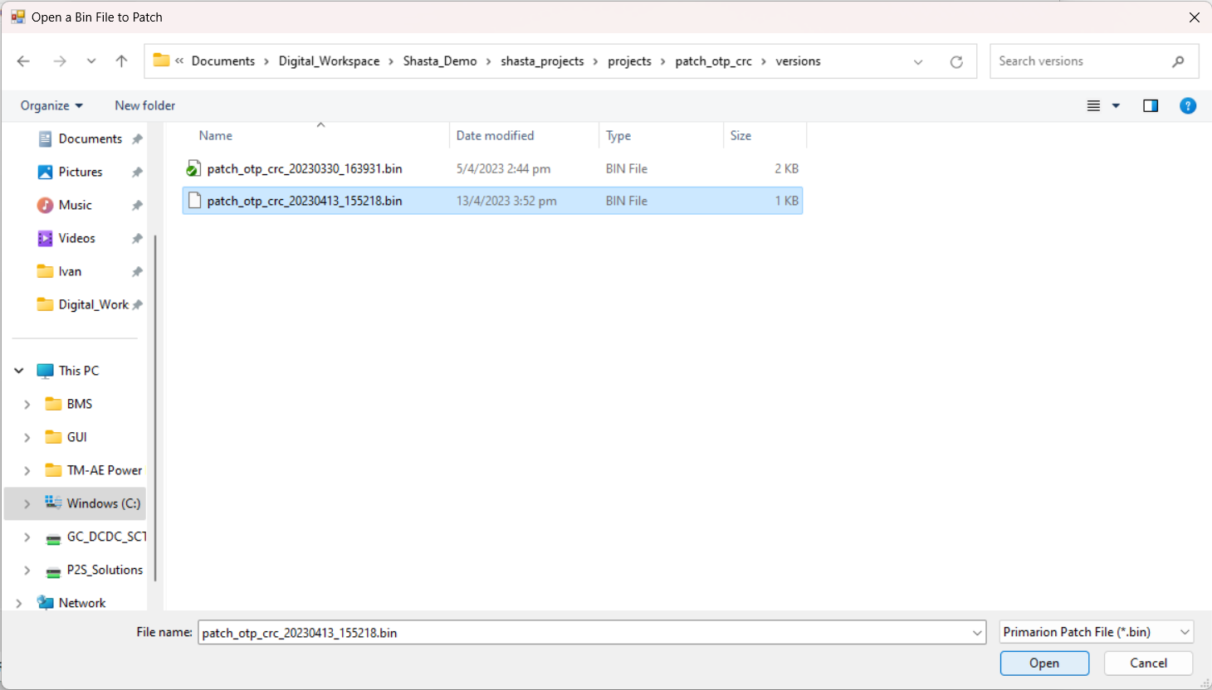
Load Firmware Patch
FW Patch is store to RAM

Slide 5
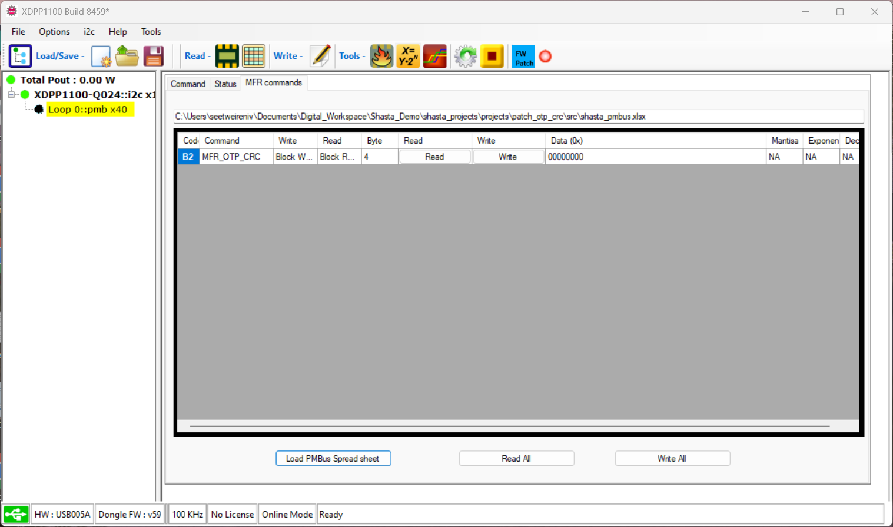
Write MFR Command 0xB2
Write 0xB2.
Write Data 0
Return read: Sum of CRC(Header and Data) in partition 0, except Partial Data(Config Partial/PMBus Partial)
Write Data not equal 0
Return result is sum of header CRC + data CRC
Write Data Format [0:7]: file system image type see Otp_File_System_Cmd_Types_t [8:15]: xvalent number 0-15 [16:23]: reserved [24:31]: otp partition see Otp_Partition_Selector_t for details should be number between 0-17;

Slide 6
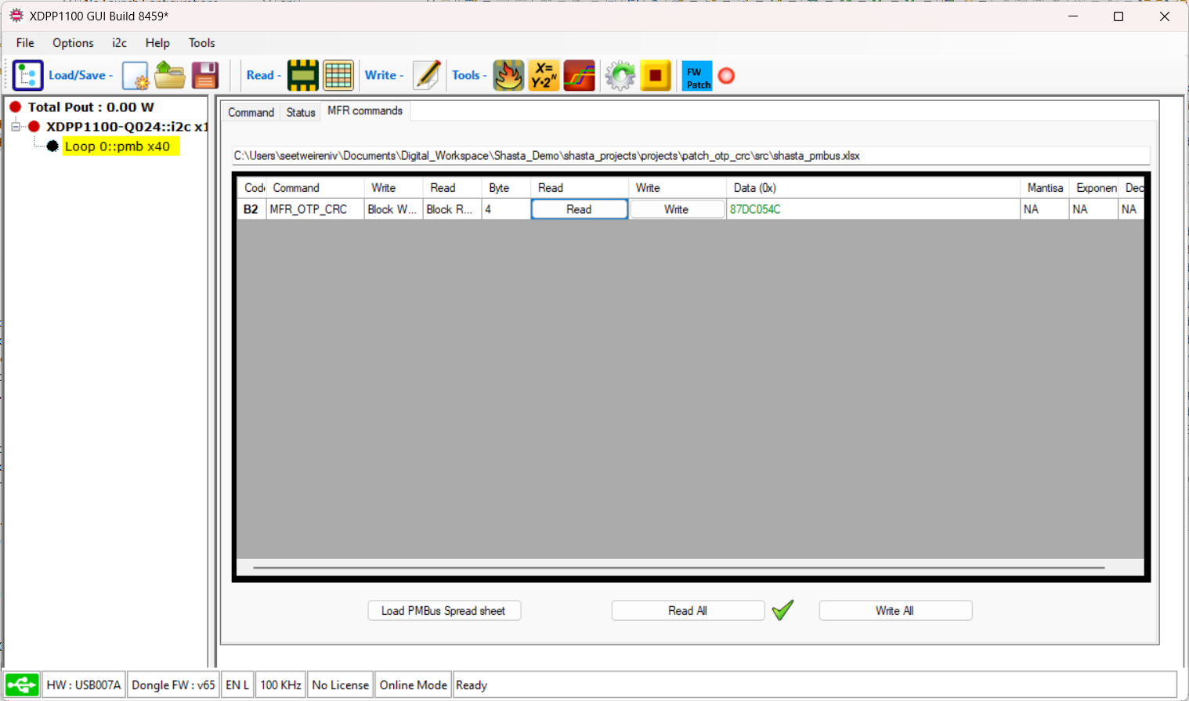
Read MFR Command 0xB2
Click Read 0xB2 after Write to get the result.
Note: The sum of CRC is round to 4bytes. The 5th bytes is not display for sum of CRC.

